Slide 1
NATIONAL EDUCATION POLICY 2020 An introductory understanding for the Higher Education system Govt of Karnataka
Prof. Syed Ashfaq Ahmed

Slide 2
The timeline
‘Some Inputs for the Draft National Education Policy, 2016’ – draft Paper prepared by MoE (the then MHRD)
June 2017 a ‘Committee for the Draft National Education Policy’ constituted
Draft National Education Policy, submitted to GoI in May, 2019.

Slide 3
The Union Cabinet approved the National Education Policy 2020 on July 29, 2020 for implementation.
Govt of Karnataka Implementing NEP on 23.08.2021
This policy replaced the 34 year old National Policy on Education (NPE),1986.

Slide 4
National Education Policy (New Educational Policy - 2020)
3rd 2020 – National Education Policy | Focus on skill enhancement Upgrading the quality of education Reinforcing the centrality of the teacher Adopting a multi-disciplinary approach involving both skills and learning. India after 30 years of New Economic Policy – growth and consolidation of services sector –recognised as a skill-based HR industry (IT and allied)

Slide 5
The Indian Higher Education ecosystem (AISHE REPORT 2019-20, released in December 2020)
1043 Universities in India and 42343 Colleges
432 State Universities
(including Government and aided Deemed Universities)
407 private Universities
(including Deemed Private)
135 Institute of National importance
48 Central Universities

Slide 6
Total enrolment in higher education has been estimated to be 40 million (400 lakhs)
Distance enrolment constitutes about 10.62%
The total number of teachers are about 15 lakh
Average PTR is 1:975

Slide 7
NEP at the School level

Slide 9
What does this Policy seek to achieve in Higher Education
Focus on skill enhancement
Upgrading the quality of education
Reinforcing the centrality of the teacher
Adopting a multi-disciplinary approach involving both skills and learning.
Entire adult population of the country to be literate by 2030 and GER to be at 50% from the present 23%

Slide 10
How is this proposed: main points
All Universities to be multi-disciplinary by 2040. No more subject specific universities.
Deemed, Unitary, Affiliating University to be phased out. Only the word University to be used.
Based on the core activities, Universities to be designated as Teaching University or Research University.

Slide 11
Affiliated colleges to be phased out.
All Colleges to be either autonomous or be eligible to be designated as Teaching University or Research University.

Slide 12
CBCS to be in place.
Credits earned can be from any discipline or field.
Vocational or skill training must.
Continuous assessments with no single High Stake exam
Freedom at University level to innovatively change, amend, add to the syllabus.

Slide 13
Harmful hierarchies eliminated – ordering of education attainment by value of the degree (certificate, diploma, degree) and differentiation between Arts, Sciences and Humanities eliminated.

Slide 14
The NEP is a visionary and bold document.
it is the commitment of the country to better itself in a meaningful and truthful way so that the Universities actually do what they are instituted for – a specific purpose academic institution..

Slide 15
The next 10 years will decide if India continues to grow in the field of higher education with competence and quality not only training people for export but also as an import destination for intellect and manpower.

Slide 16
All degree courses at the Undergraduate level to be of 4 year duration.
Postgraduate level courses to be of one year.
M.Phil. To be discontinued
Multiple exit and entry points for the students.
Exit after 1 year with a certificate
Exit after 2 years with a diploma
Exit after 3 years with a degree
Exit after 4 years with a degree with research (Honours).

Slide 17
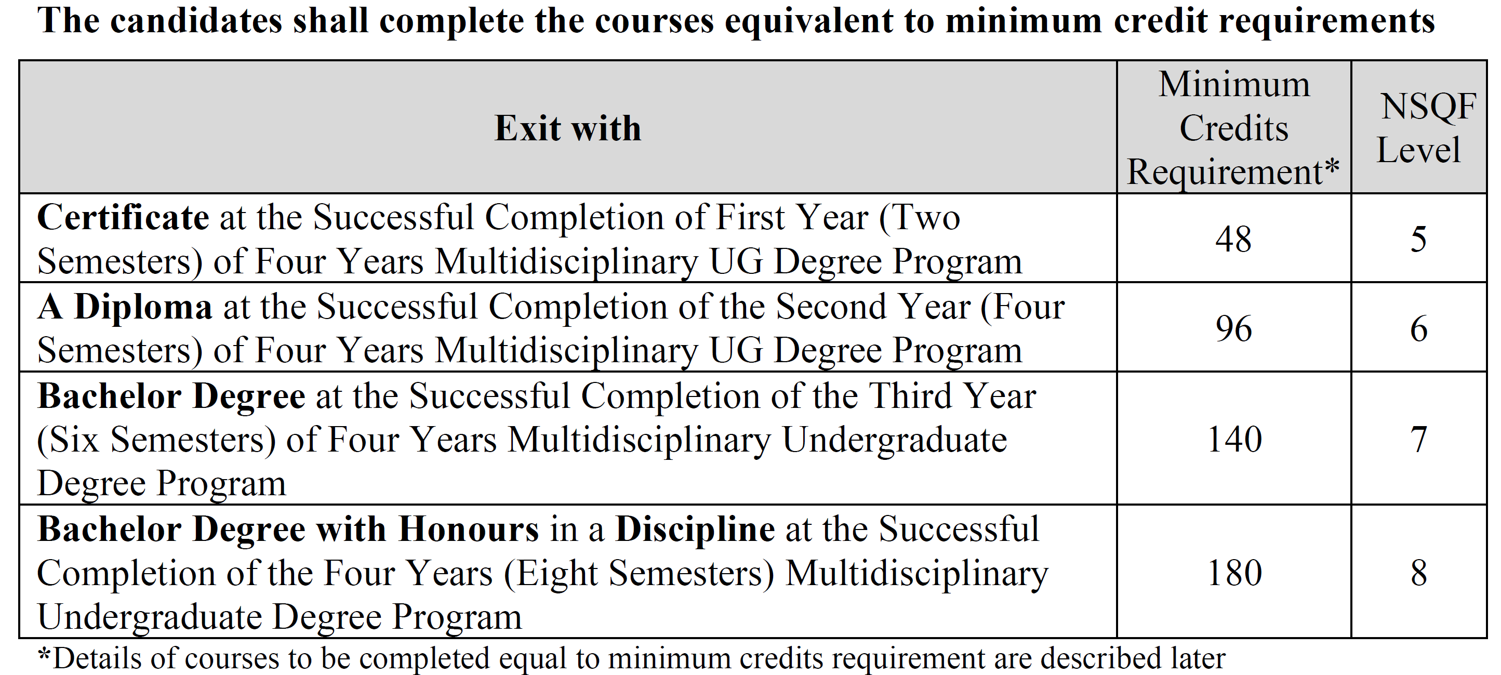

Slide 18
The students shall be required to earn at least fifty per cent of the credits from the Higher Education Institution (HEI) awarding the degree or diploma or certificate: Provided further that, the student shall be required to earn the required number of credits in the core subject area necessary for the award of the degree or Diploma or Certificate, as specified by the degree-awarding HEI, in which the student is enrolled.

Slide 19
Candidate who completes a three year Bachelor’s degree, with a minimum CGPA of 7.5 and wishes to pursue the fourth year of the undergraduate program by research, shall be allowed to continue the program with Research to obtain the Bachelor’s degree with honours by research, while other candidates may continue their studies in the fourth year of the undergraduate program with or without a research project along with other courses as prescribed for the program to complete their Bachelor’s degree with honours.

Slide 20
Candidates who wish to complete the undergraduate and the postgraduate programs faster may do so by completing the different courses equal to the required number of credits and fulfilling all other requirements in N-1 semesters (where N is the number of semesters of an undergraduate/ postgraduate program).

Slide 21
Candidates may complete both the undergraduate and the postgraduate programs on a slow track. They may pursue the three years or six-semester programs in 4 to 5 years (8 to 10 semesters) and four years or eight-semester programs in 5 to 6 years (10 to 12 semesters). As a result, higher education institutions have to admit candidates not only for programs but also for subjects or courses. But the new admissions are generally made at the beginning of an academic year or the beginning of odd semesters.

Slide 22
Credit Requirements:
The candidates shall complete courses equivalent to a minimum of
140 credits to become eligible for the Regular Bachelor Degree,
180 credits to become eligible for the Bachelor Degree with Honours 220 credits to become eligible for the Integrated Master’s Degree.

Slide 23
UG, Honours Courses

Slide 24
ACADEMIC BANK OF CREDITS (ABC)
A national-level facility will promote the flexibility of the curriculum framework and interdisciplinary/ multidisciplinary academic mobility of students across the Higher Education Institutions (HEIs) in the country with an appropriate “credit transfer” mechanism.
The multiple entries and exit options for students are facilitated at the undergraduate and Master’s levels. “Academic Bank Account” opened for students across the country to transfer and consolidate the credits earned by them by undergoing courses in any of the eligible HEIs

Slide 25
Study Webs of Active Learning for Young Aspiring Minds (SWAYAM:) is India’s national Massive Open Online Course (MOOC) platform (www.swayam.gov.in), designed to achieve the three cardinal principles of India’s Education Policy: access, equity, and quality.
now facilitates an institution to allow up to 40 per cent of the total courses being offered in a particular program in a semester through the online learning courses offered through the SWAYAM platform.
Universities with the approval of the competent authority may adopt SWAYAM Courses for the benefit of the students.

Slide 26
The candidate who completes the four years Undergraduate Program, either in one stretch or through multiple exits and re-entries would get a Bachelor’s degree with Honours.
The four years undergraduate Honours degree holders with a research component and a suitable grade are eligible to enter the ‘Doctoral (Ph.D.) Program’ in a relevant discipline or to enter ‘Two Semester Master’s Degree program with project work’.

Slide 27
Candidates who wish to enter the master’s/doctoral program in a discipline other than the major discipline studied at the undergraduate programs, have to take additional courses in the new discipline to meet the requirement or to make up the gap between the requirement and the courses already studied.
There may be parallel five-year integrated master’s degree programs with exit options after the third and fourth years, with the undergraduate degree and undergraduate degree with honours in a discipline, respectively.

Slide 28
ELIGIBILITY FOR ADMISSIONS
B.A., B.S.W. BFA, BPA, and BVA (Basic and Hons. degrees)
A candidate who has passed the two years Pre-University Examination conducted by the Karnataka Pre-University Education Board or any other examination considered as equivalent thereto shall be eligible for admission to these programs.

Slide 29
B.Sc. (Basic and Hons. degrees) and M.Sc. (Integrated) Programs
A candidate who has passed the two years Pre-University Examination conducted by the Pre-University Education Board in Karnataka or any other examination considered as equivalent thereto shall be eligible for admission to these programs.
Generally, a candidate to opt for a subject should have studied that subject at the qualifying examination. Psychology, Home Science, etc. may be exceptions to this requirement.

Slide 30
Continuous Formative Evaluation/ Internal Assessment:
Total marks for each course shall be based on continuous assessments and semester-end examinations. As per the decision taken at the Karnataka State Higher Education Council, it is necessary to have a uniform pattern of 40: 60 for IA and Semester End theory examinations respectively and 50: 50 for IA and Semester End practical examinations respectively, in all the Universities, their Affiliated and Autonomous Colleges.
Total Marks for each course = 100%
Continuous assessment (C1) = 20% marks
Continuous assessment (C2) = 20% marks
Semester End Examination (C3) = 60% marks.

Slide 31
Outline for continuous assessment activities for C1 and C2

Slide 32
Minimum for Pass
No candidate shall be declared to have passed the Semester Examination as the case may be under each course/paper unless he/she obtains not less than 35% marks in written examination / practical examination and 40% marks in the aggregate of written / practical examination and internal assessment put together in each of the courses and 40% marks (including IA) in Project work and viva wherever prescribed.

Slide 33
Vocational Subjects:
Advertising, Computer Applications, Communicative English, Electronic Equipment Maintenance, Entrepreneurship Development, Instrumentation, Office/Home Management and Secretarial Practice, Sales Promotion and Management, Tax Procedure and Practice, Tourism and Travel Management and any other subjects introduced from time to time.

Slide 35
Thank you

